Slide 1

Extract Transform Load
CSV to MoNGO DB
Joel Wiggins

Slide 2
Tech Requirements
Data Sources
Resume Dataset
Online Job Posting
CSV download with API available
Python
Pandas
Zipfile
Pymongo
Chardet
.to_dict(‘records)
df.replace('[^a-zA-Z\d\_.]+',' ',regex=True)
Database
MongoDB
Resume
job

Slide 3
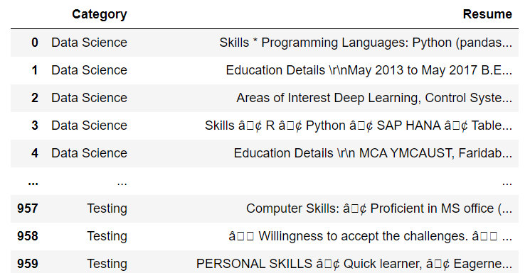
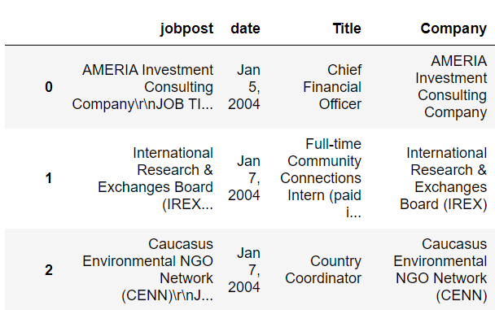
Export CSV
Imports
Imported 900+ resumes as a zip file
Imported 19,000+ job descriptions as a zip file
API available but not used
Data includes encoding errors after exporting

Slide 4
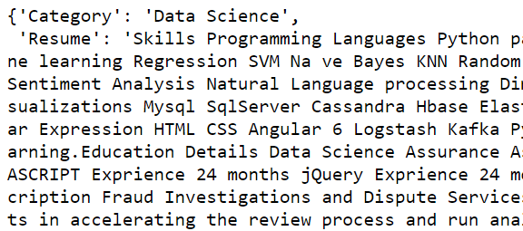
Transform with Python
Data cleaning
Used “chardet” to determine correct encoding
Removed characters outside of the utf-8 encoding using regex
Try to preserve everything as is that could fit in the database as a ground truth.
A=jobs_import_clean.to_dict('records')

Slide 5
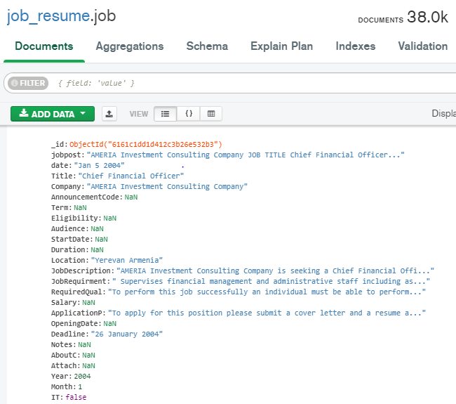
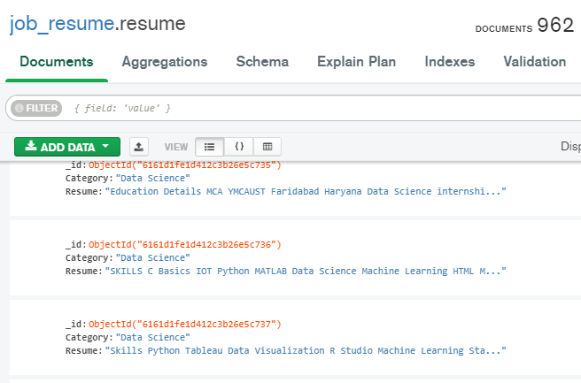
Load to Mongo DB
Database set up
Used python to set up Mongo database connection
Validated everything was a string
Inserted records with python

Slide 6

Time considerations
Job to resume similarity
Scrape additional data
Incorporate cloud database

Slide 7

Questions?
Joel Wiggins

